Slide 1
Agile Quality Assurance
Prof. Dr. Dirk Riehle
Friedrich-Alexander University Erlangen-Nürnberg
AMOS F01
Licensed under CC BY 4.0 International
Notes:
It is Friedrich-Alexander University Erlangen-Nürnberg – FAU, in short.
Corporate identity wants us to say “Friedrich-Alexander University”.

Slide 2
Agenda
Test-first programming
Test-driven development
Pair programming
Pre-commit code review
Build management
Continuous integration
Continuous delivery

Slide 3
1. Test-First Programming

Slide 4
Test-Driven Development in Context
Tests and testing
Test-first programming
Test-driven development

Slide 5
Tests and Testing
Testing is a process
  that tests some concern (the concern “under test”)
  for correct and expected operation
  according to a specification
  usually as part of quality assurance
Tests can be manual or automated
Tests verify against a given specification
Tests increase confidence in correct functioning
However, tests can never proof a program correct

Slide 6
Types of Tests [1]
Components tests (a.k.a. unit tests)
  Focus on testing one component out of context
Acceptance tests (a.k.a. functional tests)
  Focus on testing one cross-cutting functionality
Integration tests (a.k.a. system tests)
  Focus on testing end-to-end system integrity
[1] This is a simplification for the purposes of this course.

Slide 7
Tests and Testing Terminology
Test (case)
  A single test for some particular aspect of the software, succeeds or fails
Test suite
  A set of related tests that cover a particular domain of the software
Test set-up
  The data and preparation necessary to run a test as intended
Test result
  The result of running a test, either succeed or fail, or a test error
Test harness (framework)
  A software, like JUnit, that is used to simplify the implementation of tests

Slide 8
Test-First Programming [B02]
Test-first programming is a practice in which developers
  Write a test before they implement the actual functionality and
  Iterate over an “add new or enhance test, make test work” loop
Functionality is a by-product of making the tests work
  Test-first programming
    clarifies code functionality and interfaces
    improves code quality through second use scenario
    builds up test suite for continuous integration (later)

Slide 9
Test-First Rules 1 / 2
Only write new code
when a test fails
Then, eliminate waste

Slide 10
Test-First Rules 2 / 2
Red
Green
Refactor

Slide 11
2. Test-Driven Development

Slide 12
Test-Driven Development (TDD) 1 / 3
Test-driven development
  Is a minimal development process based on test-first programming
  Turns feature requests into implementations
Purpose of test-driven development
  To grow the product incrementally and steadily
  To be able to release after every feature implementation

Slide 13
Test-Driven Development 2 / 3
Translate partial or full feature description into test suite
Implement feature to fulfill (“green-bar”) test suite
Revise test suite from new insights
Refactor test suite to keep design and code clean
Refactor implementation to keep design and code clean
Move on when test suite is complete and all tests succeed
3
6
1
2
feature
test suite
implementation
4
5

Slide 14
Test-Driven Development 3 / 3
...
feature n+2
feature n+1
on to next feature
enhance test suite
feature n
test suite n
implementation n
feature n-1
test suite n-1
implementation n-1
feature n-2
test suite n-2
implementation n-2
...
...
...

Slide 15
3. Pair Programming

Slide 16
Code Review
Definition and purpose
  “Code review is systematic examination […] of computer source code.
    It is intended to find and fix mistakes overlooked in the initial development phase,
      improving both the overall quality of software
      and the developers’ skills.
  Reviews are done in various forms such as
    pair programming,
    informal walkthroughs, and
    formal inspections.” [1]
[1] Adapted from https://en.wikipedia.org/wiki/Code_review

Slide 17
When to Review Code?
In the moment
Before commit
At another time
Before release

Slide 18
Agile Code Review Practices
Pair programming
Pre-commit code review

Slide 19
Pair Programming
Definition
  Is programming carried out by pairs of programmers
  One programmer implements, and the other programmer reviews
  Effectiveness is debated; empirical studies show conflicting evidence
Purpose
  Quality assurance
  Collaborative learning
  Knowledge sharing
Synonyms
  Programmer and reviewer
  Driver and co-driver
  Pilot and navigator

Slide 20
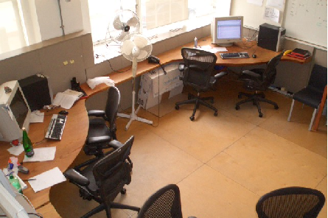

Pair Programming (Practices)
Process
  Find comfortable partner
  Switch roles often
  Communicate regularly
Advice
  Don’t force it for small stuff
  Don’t overheat, take a break
  Switch partners at times

Slide 21
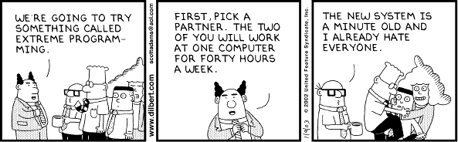
Dilbert on Pair Programming 1 / 2

Slide 22
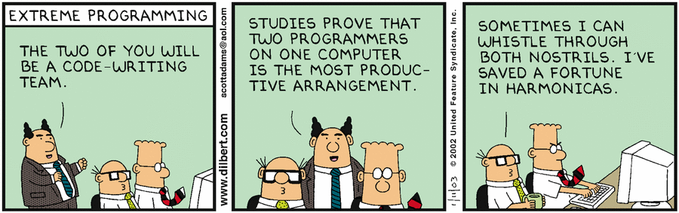
Dilbert on Pair Programming 2 / 2

Slide 23
4. Pre-Commit Code Review

Slide 24
Pre-Commit Code Review
Code review
  Is the (peer) review of source code for quality criteria
  Reviewer has accept or reject responsibility
  Cf. “Vier-Augen-Prinzip” (in German)
Pre-commit code review
  Is the review of source code before it gets committed to a team repository
  Typically facilitated by a software tool, e.g. Gerrit
  May lead to back and forth between developers until “LGTM”

Slide 25
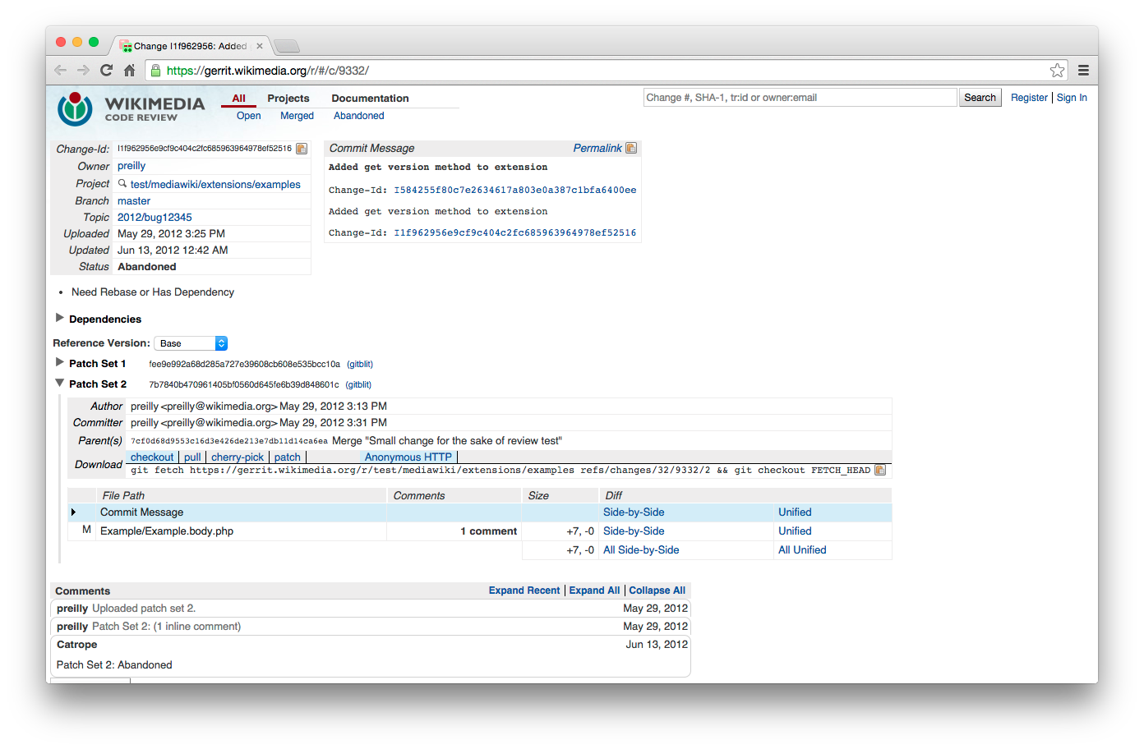
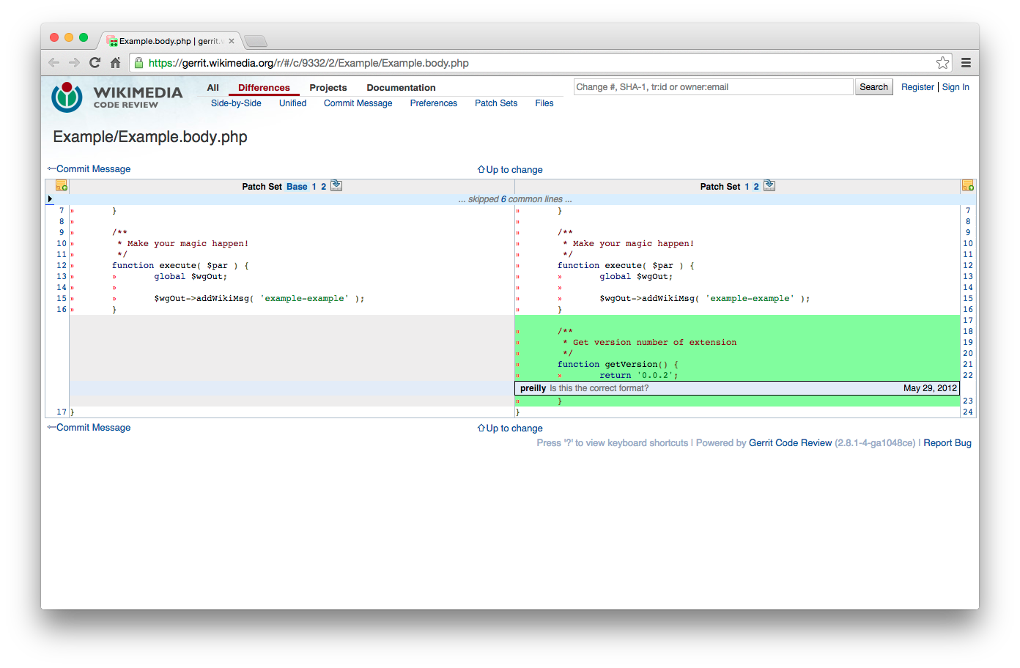
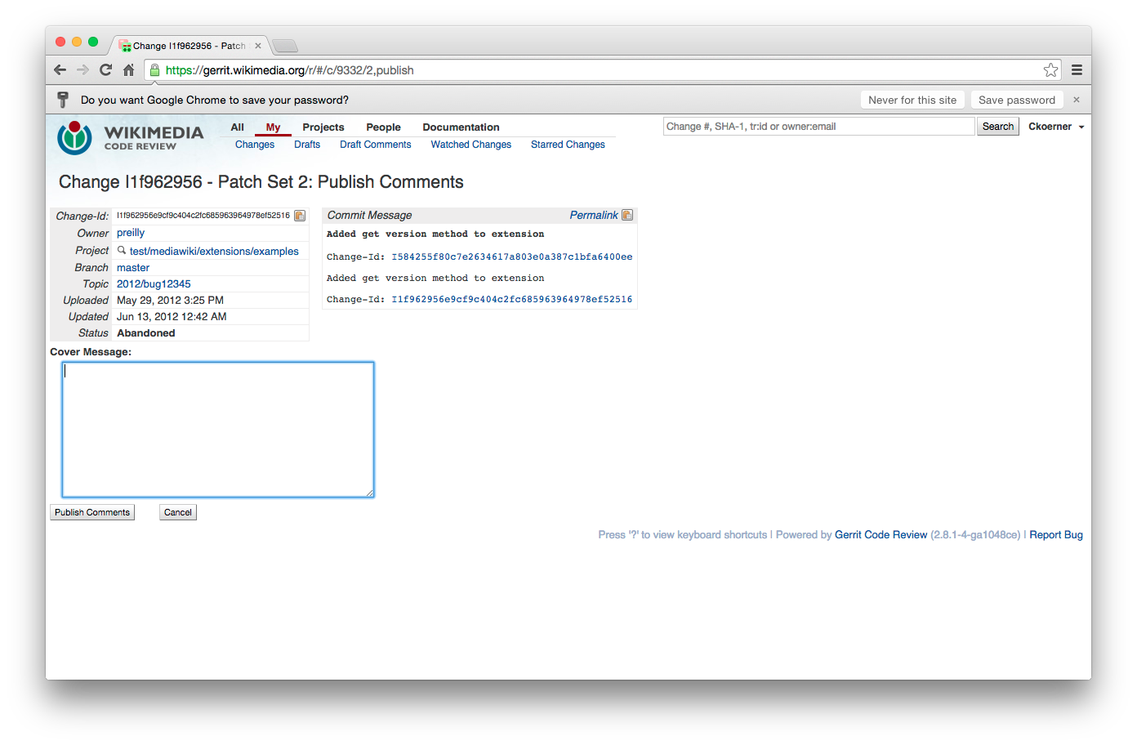
Example Code Review with Gerrit
[1] See https://www.mediawiki.org/wiki/Gerrit/Tutorial

Slide 26
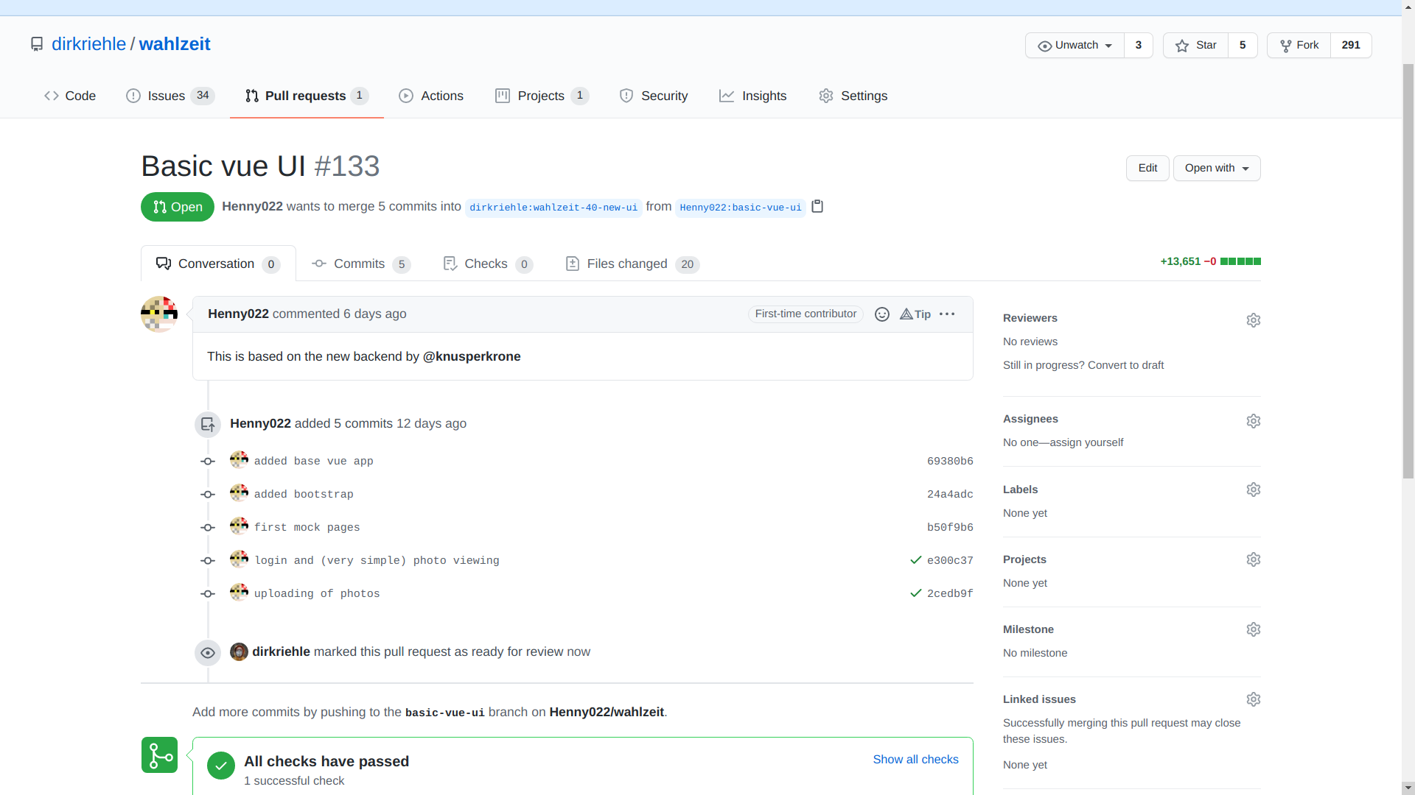
Example Code Review in Distributed Work (Merge Requests)

Slide 27
Benefits of Pre-commit Code Review
Collaboration
  Improves knowledge sharing and teamwork
  Makes it easier to establish topics like security
Quality assurance
  Leads to more disciplined developers
  Prevents (some) errors before they happen
  Raises overall quality standards
Feeling of responsibility
  Specifically, supports collective code ownership
  Strengthens overall feeling of responsibility

Slide 28
Agile vs. Open Source Code Review
Agile methods
  Programming guidelines
    Code reading >> writing
    Make it easy to get acquainted
  Collective code ownership
    Feature-oriented development
    Typically co-located development
    Everyone has write access
  Pair programming
    Changes are reviewed directly
    Everyone is a peer
Open source
  Programming guidelines
    Code reading >> writing
    Showing respect for project
  Individual code ownership
    Component-oriented development
    Typically distributed development
    Strictly regulated write access
  Patch review
    Changes are submitted for review
    Two-class reviewing hierarchy

Slide 29
5. Build Management

Slide 30
Professional Development Cycle
Developer
Environment
Test
System
Production
System
QA engineer
  Fetches code
  Builds full system
    Deploys in test system
  Tests full system
    Automated and by-hand
      Component tests
      Acceptance
      Integration tests
  Deploys full system
  Operates system
edit
compile
fetch
fetch
build
build
build
deploy
deploy
deploy
test
test
monitor
commit
release
operate

Slide 31
Build Process
Definition
  Is the defined and (ideally automated) process of deriving an installable product from its source artifacts
Purpose
  Defines a standard environment
  Provides developers with setup
  Defines clear commit rules
  Manages test data etc.

Slide 32
Developer Responsibilities
Only work in defined standardized environment
  This ensures no subtle differences to central build process
Only commit / push code that compiles and works
  “Breaking the build” through non-compiling code hurts team
Only commit / push code that passes all the tests
  Failing tests quickly degenerate system (hard to catch-up)

Slide 33
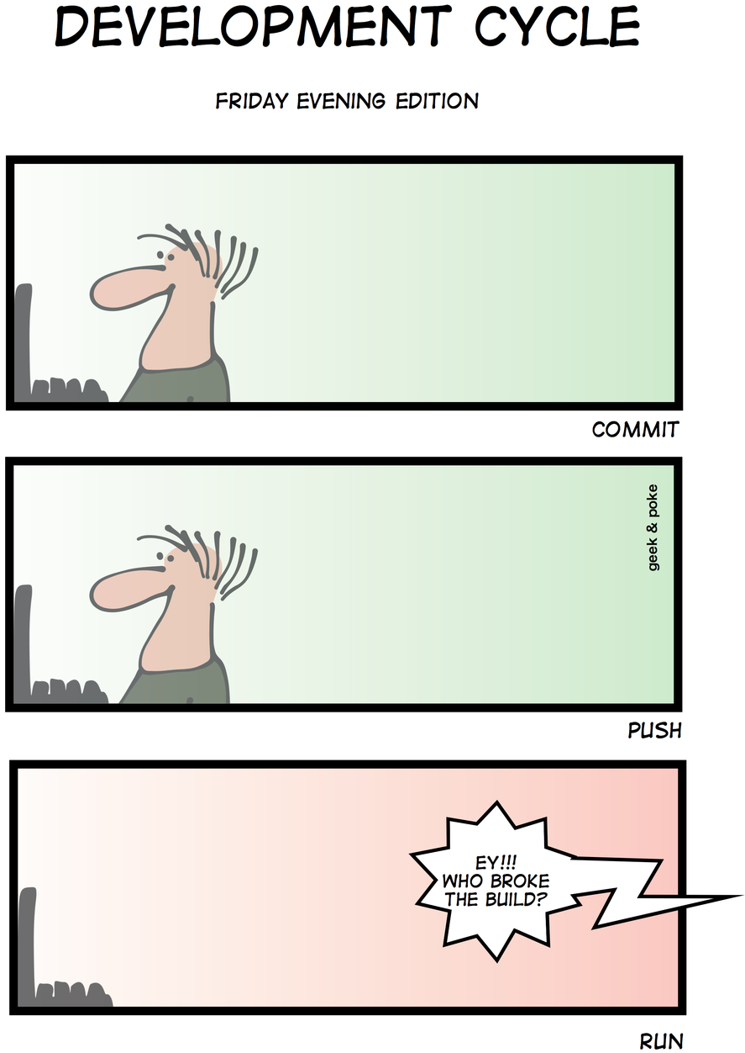

Slide 34
Build Asset Management
Management by hand
  Libraries are curated by hand
Automated management
  Libraries are pulled in automatically
Bill of materials
  Possibly generated automatically

Slide 35
Quiz: Supply Chain Effects
Last week you delivered your product release to your client. The phone rings and an angry client is on the line, complaining about missing their schedule. What might have gone wrong?
  The client’s development team objected
  The client’s quality assurance unit objected
  The client’s legal team objected
  All of the above

Slide 36
6. Continuous Integration

Slide 37
Continuous Integration Development Cycle
Developer
Environment
Test
System
Production
System
Release (QA) engineer
  Fetches code
  Builds full system
    Deploys in test system
  Tests full system
    Automated and by-hand
      Component tests
      Acceptance
      Integration tests
  Deploys full system
  Operates system
edit
compile
fetch
fetch
build
build
build
deploy
deploy
deploy
test
test
monitor
test automation
commit
release
operate

Slide 38
Test Automation
Test automation ...
  automatically carries out all available tests
    Component tests (unit tests)
    Acceptance tests (functional tests)
    Integration tests and system tests
  provides feedback to development and QA

Slide 39
Continuous Integration
Continuous integration (CI) is a code integration process
  Upon trigger (commit to official repository)
    the system under construction is fetched, built, deployed, and tested
    in a fully automated way (no human intervention)
  Feedback upon system status is provided to both
    developers and
    managers
The purpose of continuous integration is to
  always know where you are standing with respect to the project
  ideally improve quality such that you can deploy at any time
Continuous integration requires test-driven development

Slide 40

Continuous Integration and Lava Lamps
In the early days, lava lamps were used to signal whether the project could be deployed to production or not.

Slide 41
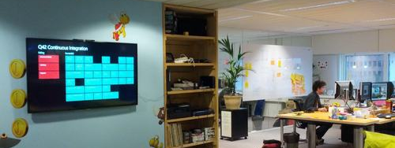
Continuous Integration Dashboards
Continuous integration quickly evolved to build and test status dashboards hung on office walls for everyone to see.

Slide 42
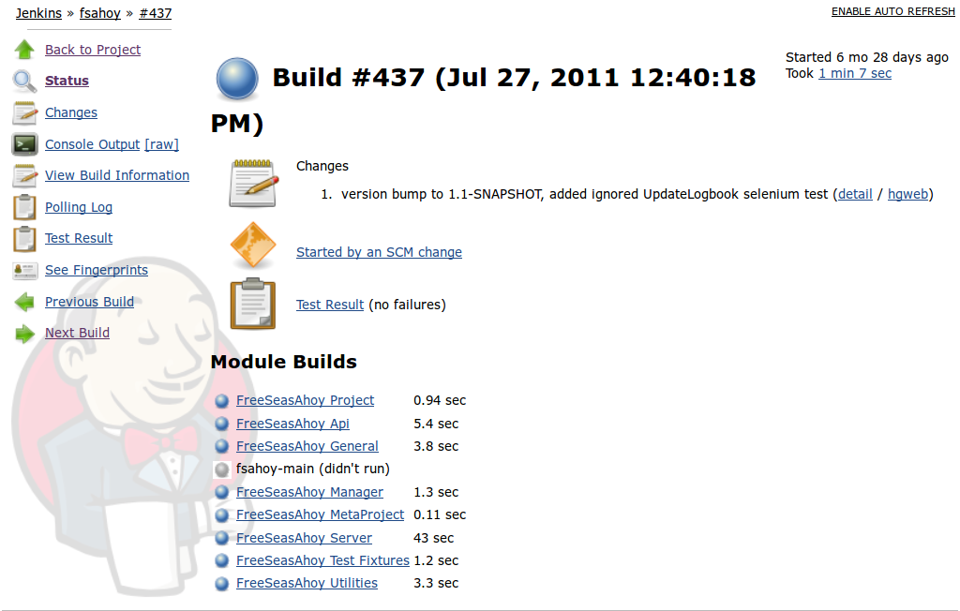
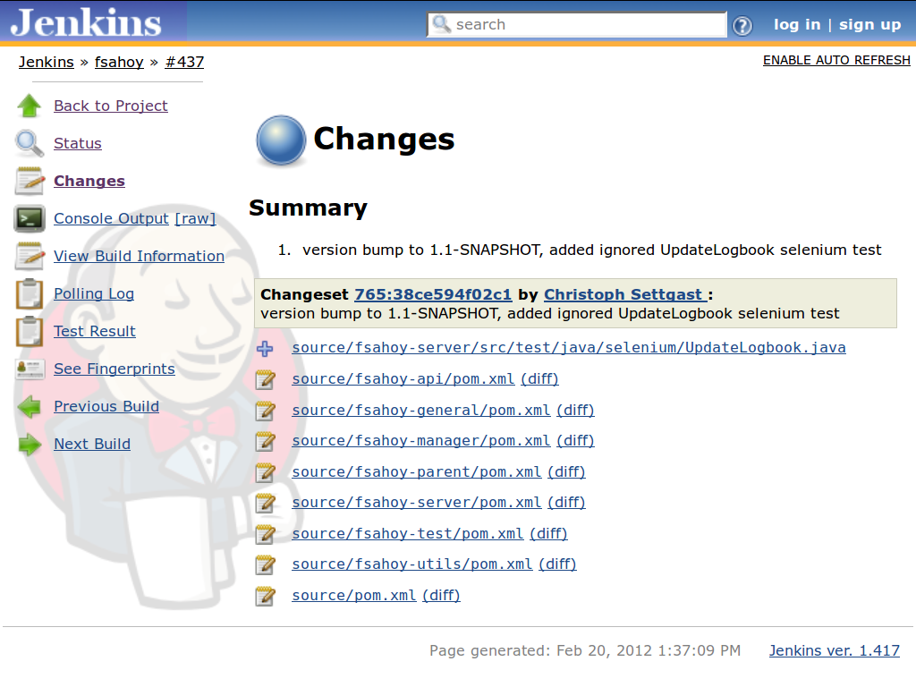
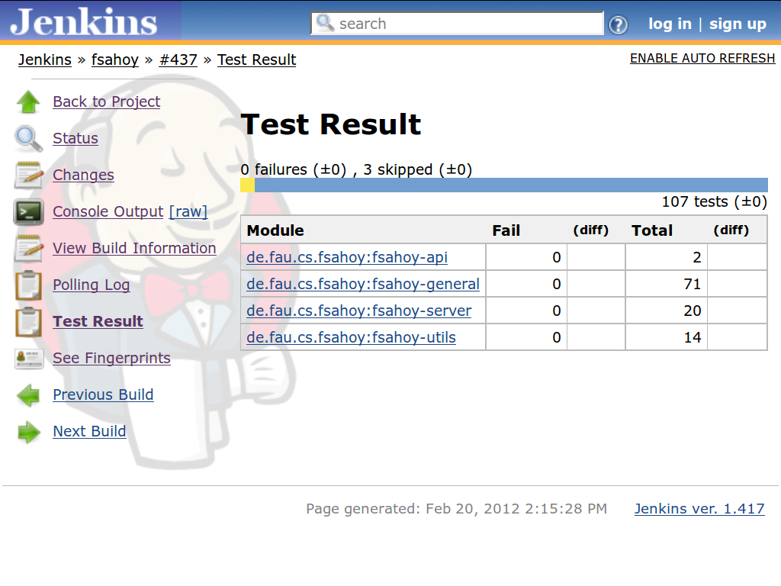
Example CI Dashboard (Jenkins)

Slide 43
7. Continuous Delivery

Slide 44
Continuous Deployment Development Cycle
Developer
Environment
Test
System
Production
System
Fully automated
  Compile and build
  Deployment
    To test environment
    To production
  Test execution
Partially automated
  System monitoring
  Automated rollback
Human decisions
  Commit decision
No release decision
edit
compile
fetch
fetch
build
build
build
deploy
deploy
deploy
Fully automated
test
test
monitor
commit
release
operate

Slide 45
Continuous Delivery
Continuous delivery is a delivery process
  Upon trigger (commit to official repository)
    the system is integrated, tested, and deployed to production
    in a fully automated way (no human intervention)
  A poorly functioning system may be rolled back
    Requires monitoring and rollback facility of deployed system
    System status is assessed using key figures
The purpose of continuous delivery is to
  put development results into production as fast as possible
  improve quality by holding the team to high operational standards

Slide 46
Continuous Delivery 1 / 2
Test automation
Continuous integration
Continuous deployment

Slide 47
Continuous Delivery 2 / 2
Test automation =
  Tests and testing
Continuous integration =
  Test-driven development +
  Automated building +
  Test automation
Continuous deployment =
  Continuous integration +
  Deploy to production +
  Monitoring and rollback
DevOps [1]
  Continuous deployment +
  Operations and culture
[1] Short for “development operations”

Slide 48
Review / Summary of Session
Test-first programming
Test-driven development
Code review practices
  Pair programming
  Pre-commit code review
Continuous integration
Continuous delivery

Slide 49
Thank you! Questions?
dirk.riehle@fau.de – https://oss.cs.fau.dedirk@riehle.org – https://dirkriehle.com – @dirkriehle
DR

Slide 50
Legal Notices
License
  Licensed under the CC BY 4.0 International license
Copyright
  © 2010-2021 Dirk Riehle, some rights reserved

